Slide 1

lightform.org.uk
Formability with MatFlow:
An open framework for automated formability predictions
Adam Plowman, Patryk Jedrasiak, Sumeet Mishra, Pratheek Shanthraj, João Quinta da Fonseca
LightForm Technical Seminar, October 2020

Slide 2

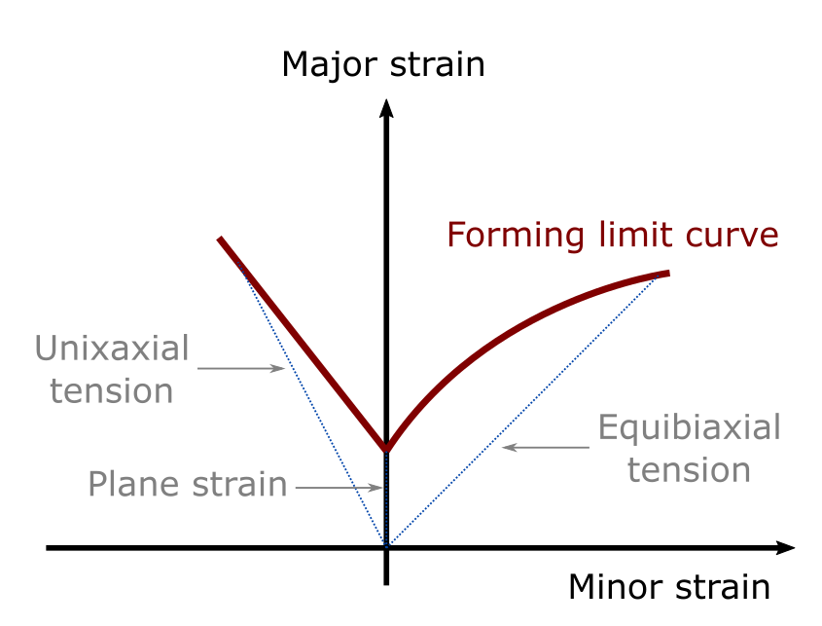
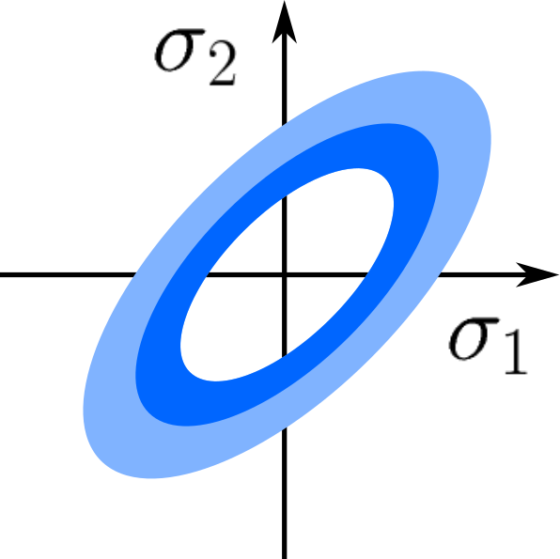
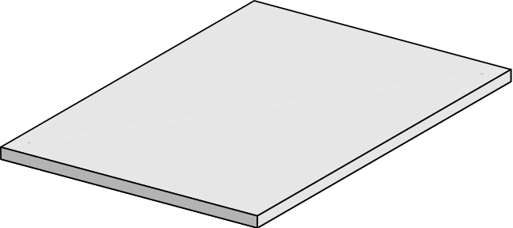
Formability
Industry perspective
Rapid growth in use of light alloys in components due to weight-savings and recyclability
Formability must be well-understood to ensure a manufactured components maintain good performance
Our aim: to facilitate this by building infrastructure for generating formability predictions
What do we need to do? Yield functions and forming limits should be quantified

Slide 3
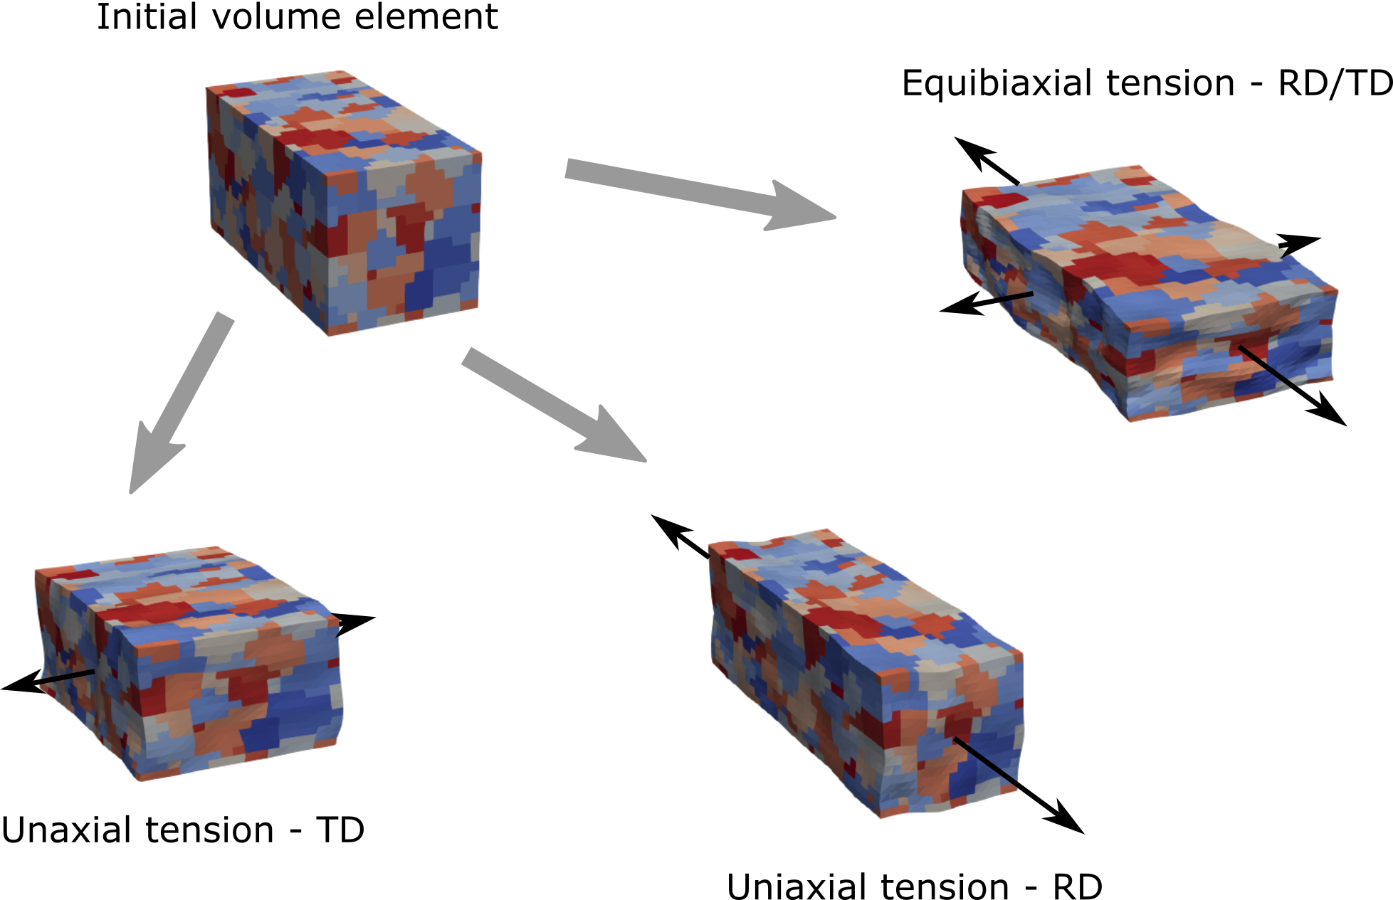
Our approach
Virtual materials testing
Virtual materials testing and a small set of experimental tests
Simulation not limited to experimentally “easy” deformation modes
Different models exist, e.g.:
Taylor
Self-consistent
Full-field
Full-field models using crystal plasticity most accurate, but expensive
Which method is most fruitful?
Deforming a volume element under different loading regimes using DAMASK (FFT CP)

Slide 4
Our approach
Computational formability framework
To provide valuable predictions, we must:
compare results of different models (e.g. is the cheaper model good enough?)
compare effect of including different experimental data (e.g. is grain morphology important?)
support heterogeneous data sources/sinks (e.g. different texture data formats; different simulation codes)
We’ve built a framework to make this process straightforward (and worth doing!)
Experimental data
Model calibration
Simulate (model A)
Processing
Formability predictions
Simulate (model B)
Formability predictions
Adopting a pipeline approach means our framework is sufficiently general

Slide 5
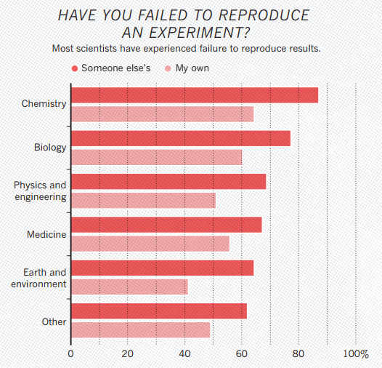
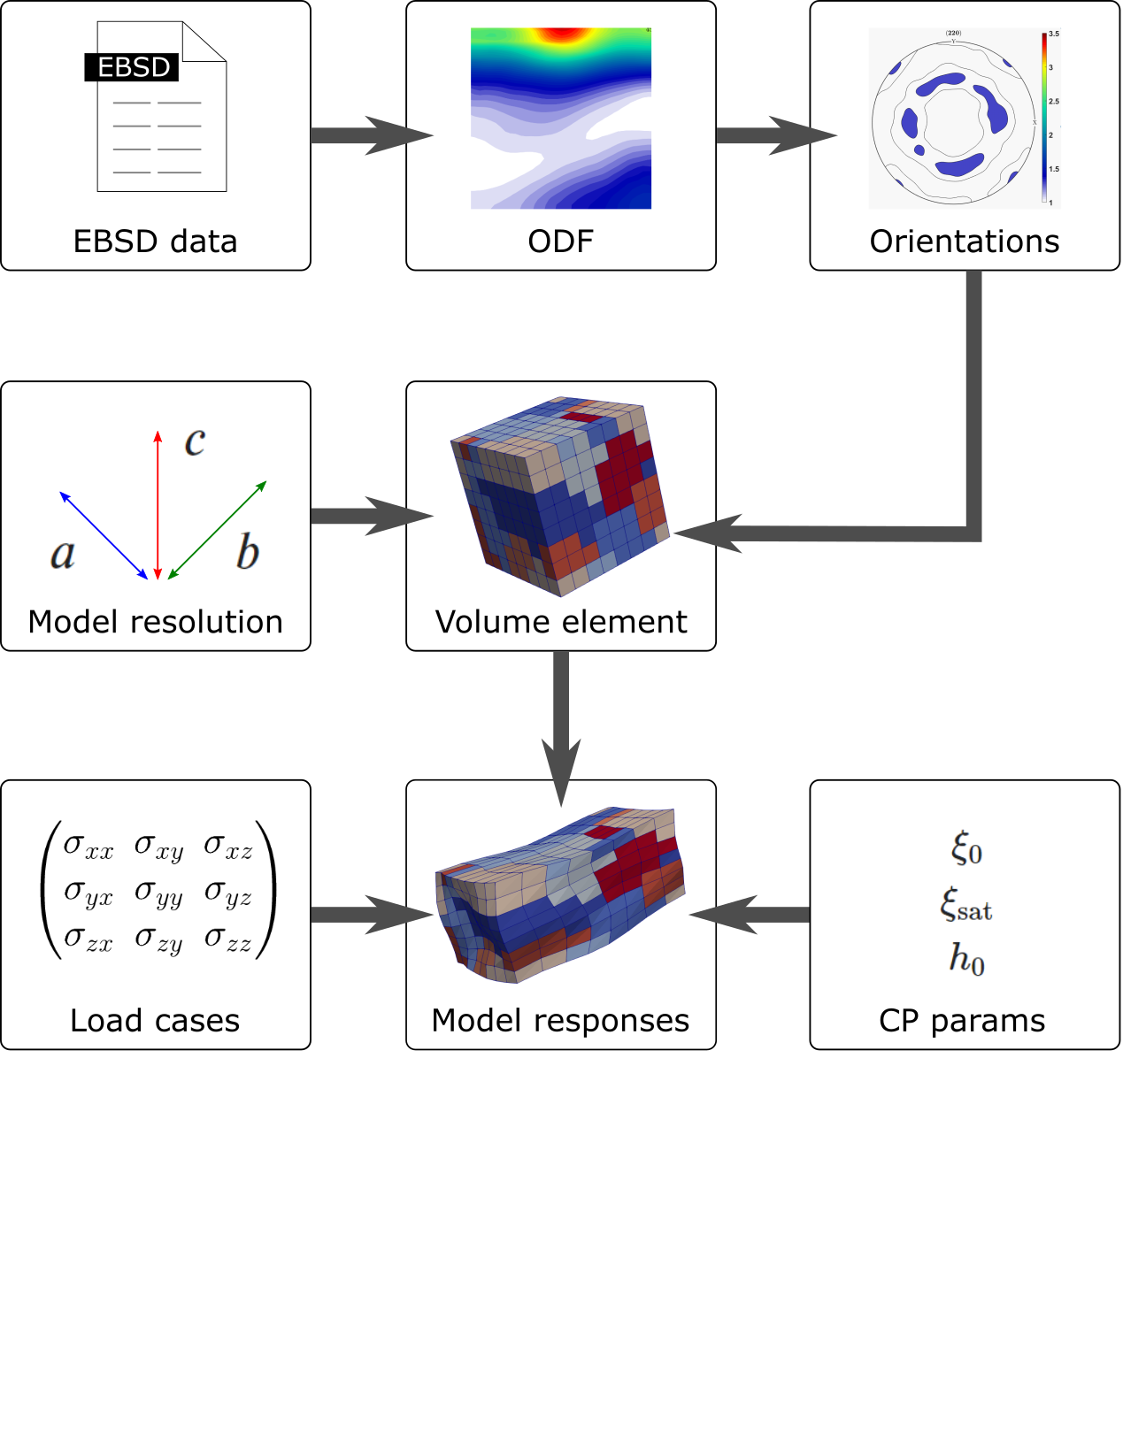
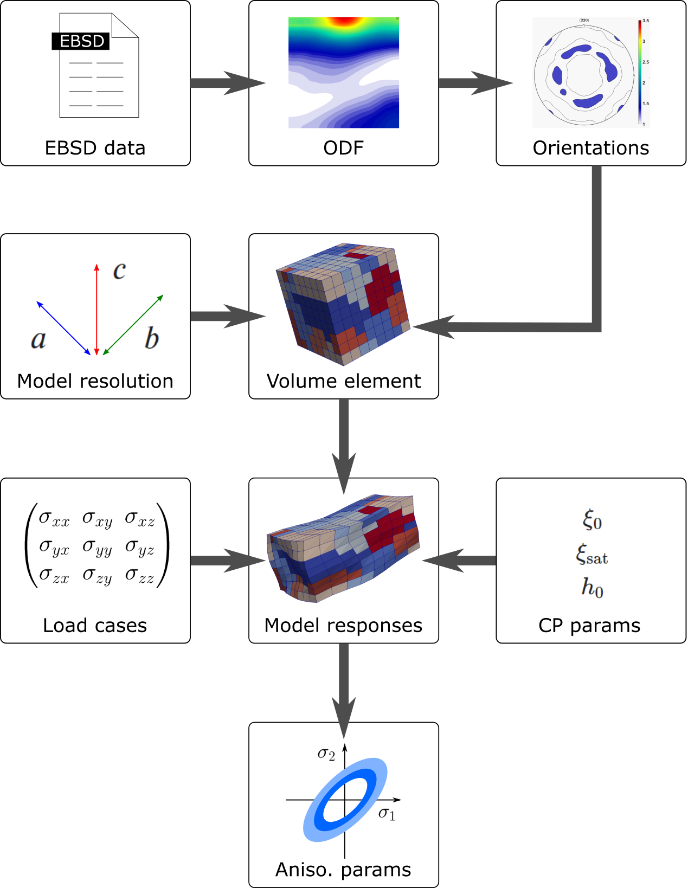
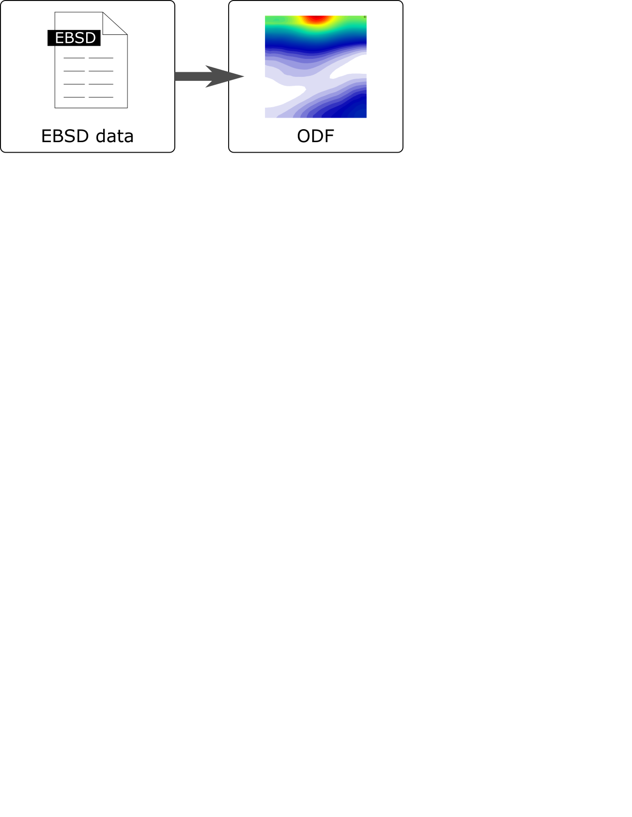
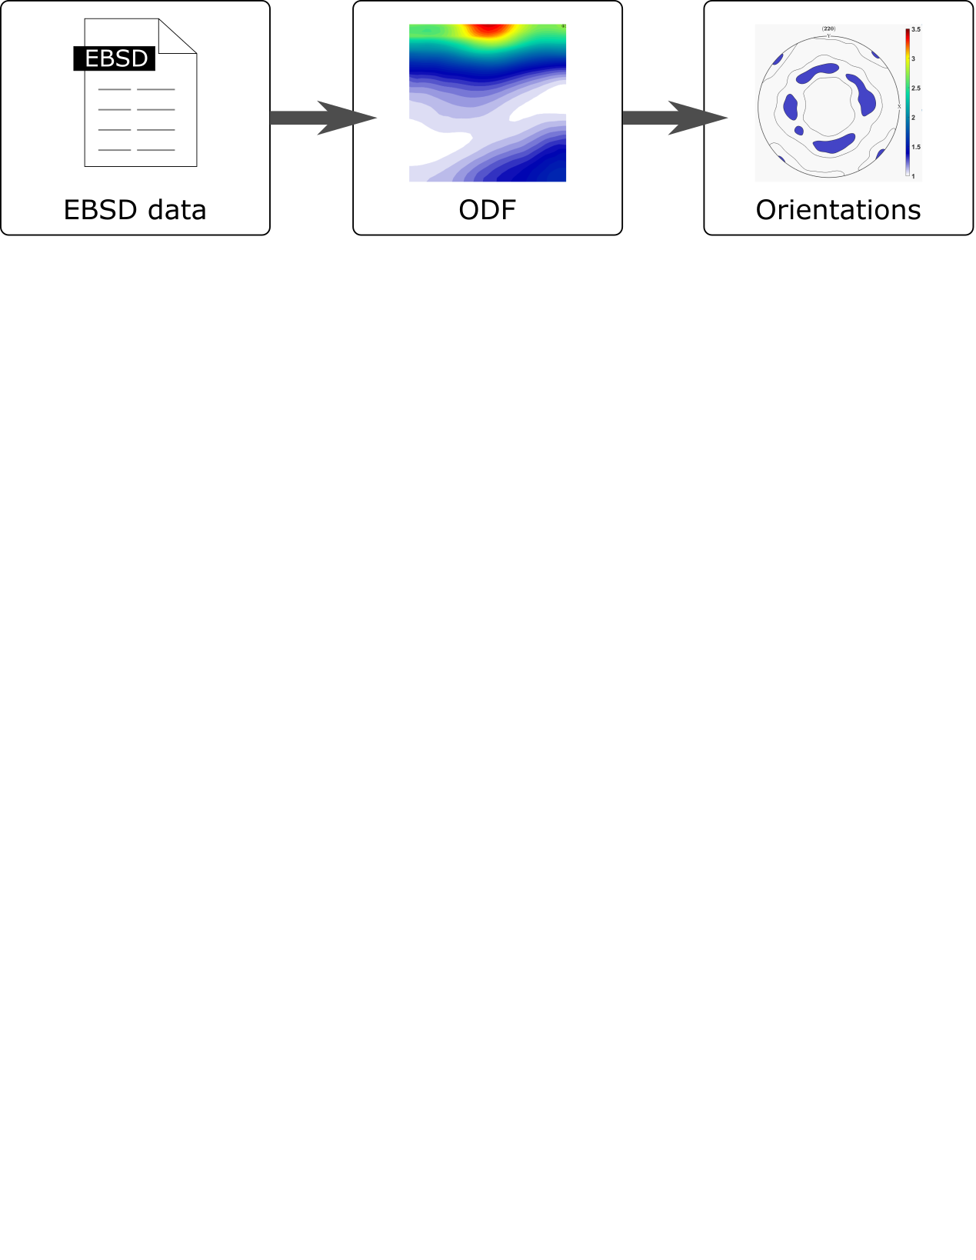
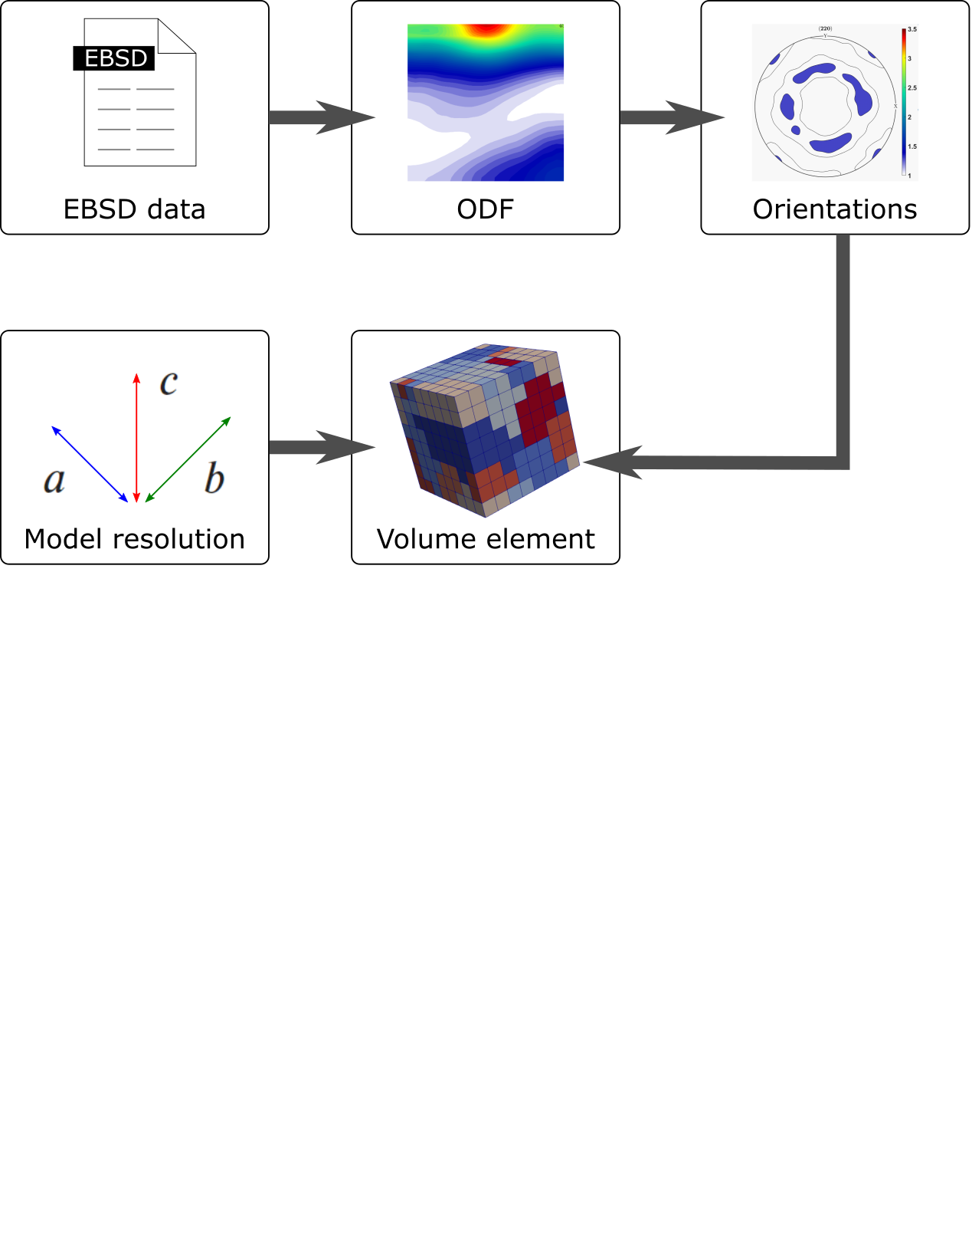

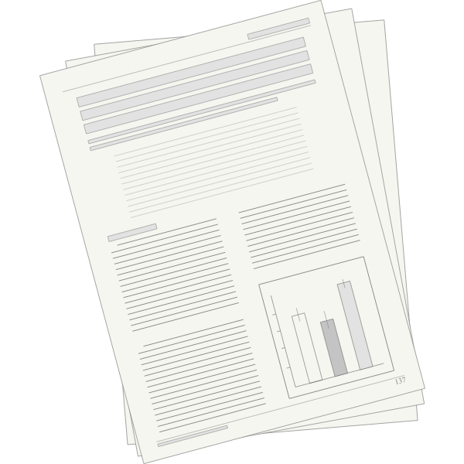
Our approach
Reproducibility and transparency
Our framework has been designed specifically to ensure reproducibility.
With our framework:
Typically:
What is accessible to the materials community?
Outputs:
Publication
Additional outputs:
Generated data (e.g. texture data)
Methods + parameters (e.g. CP parameter optimisation)
Derived data (e.g. fitted yield function parameters)
Data of a virtual materials test
Baker, Monya. ‘1,500 Scientists Lift the Lid on Reproducibility’. Nature News 533, no. 7604 (26 May 2016): 452. https://doi.org/10.1038/533452a.

Slide 6
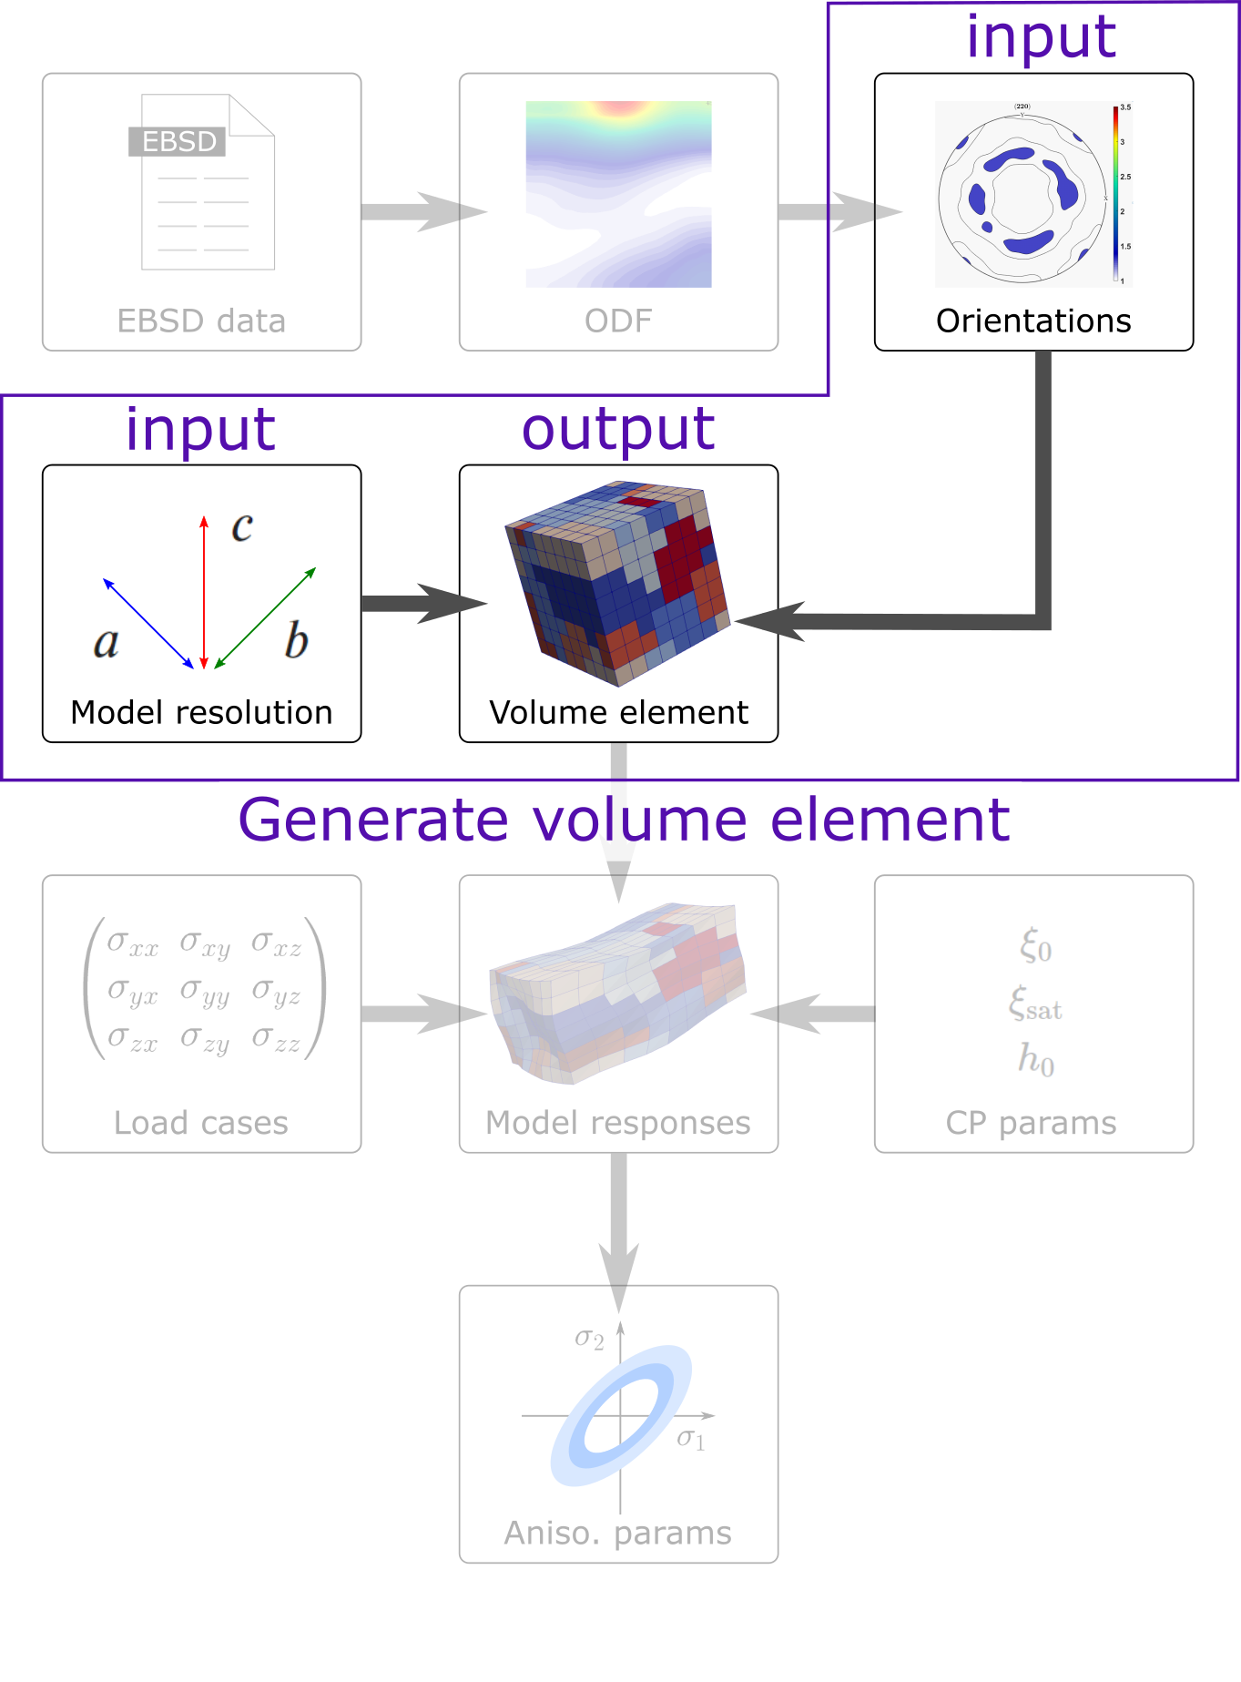
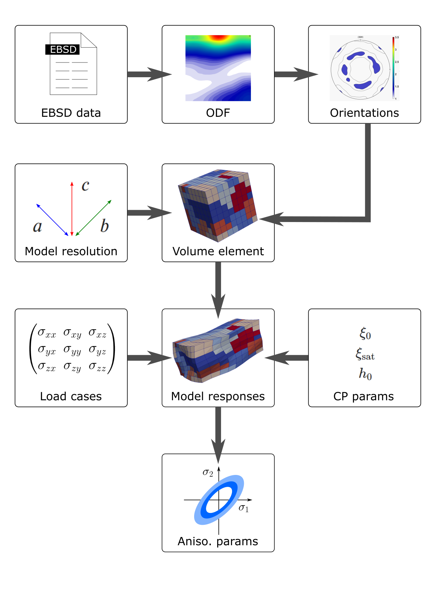
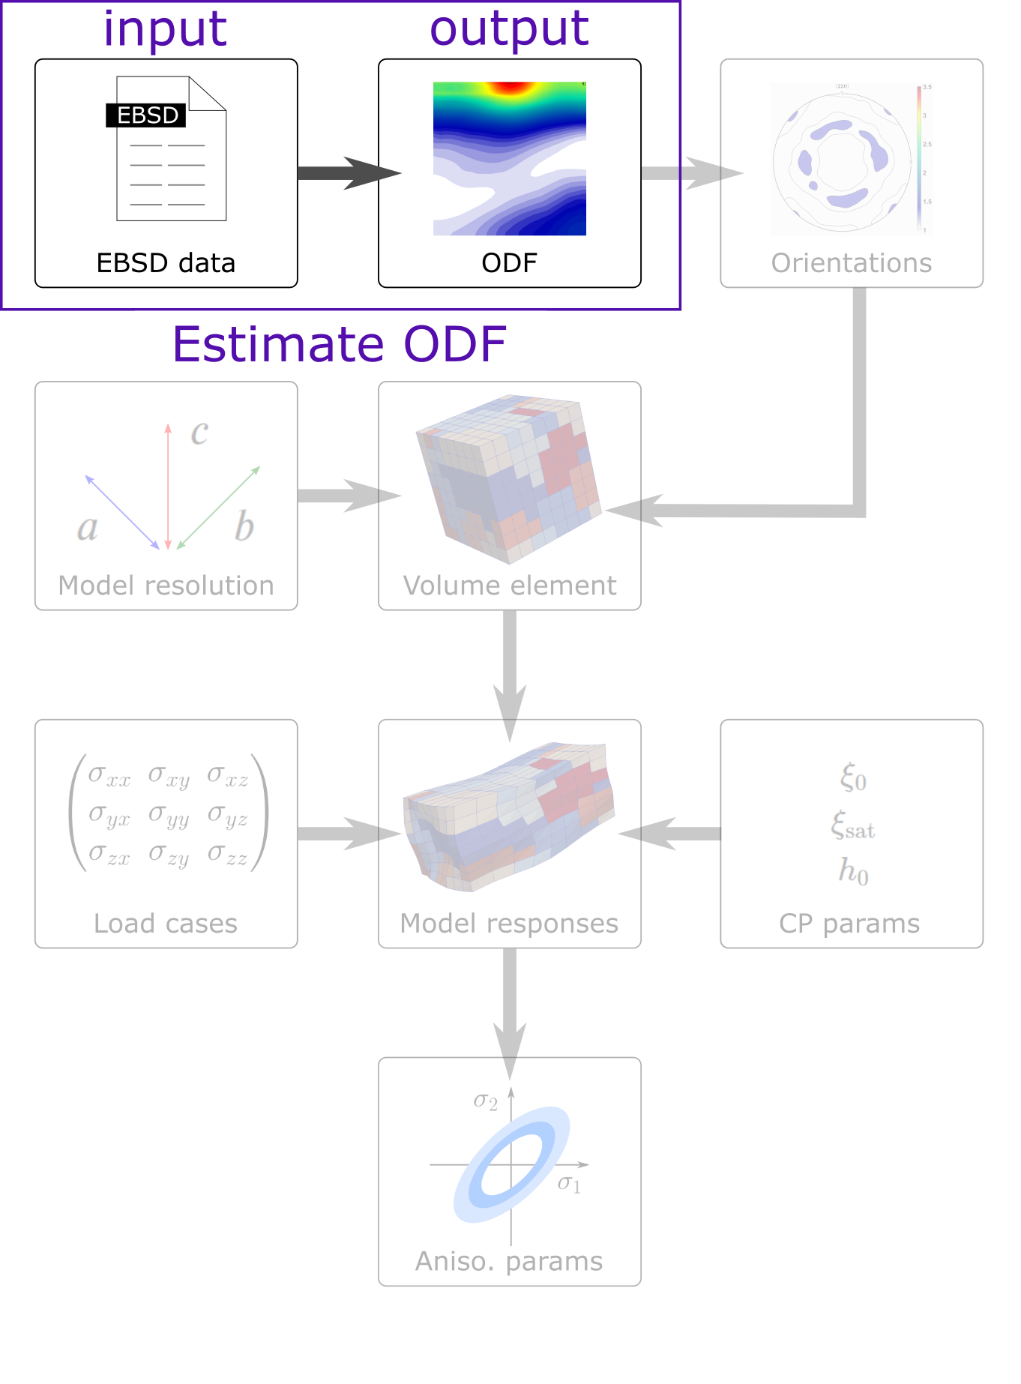
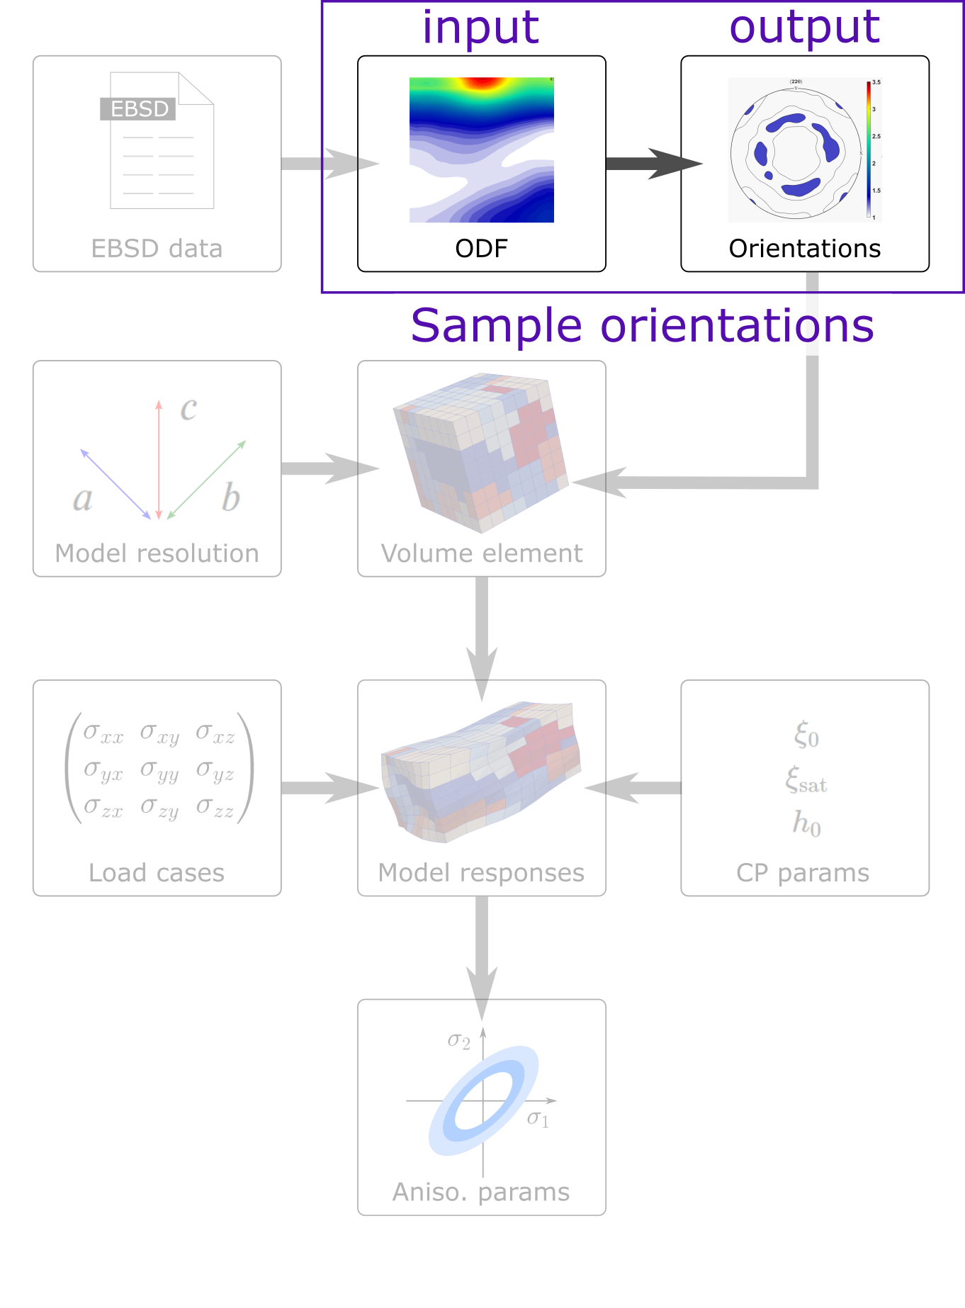




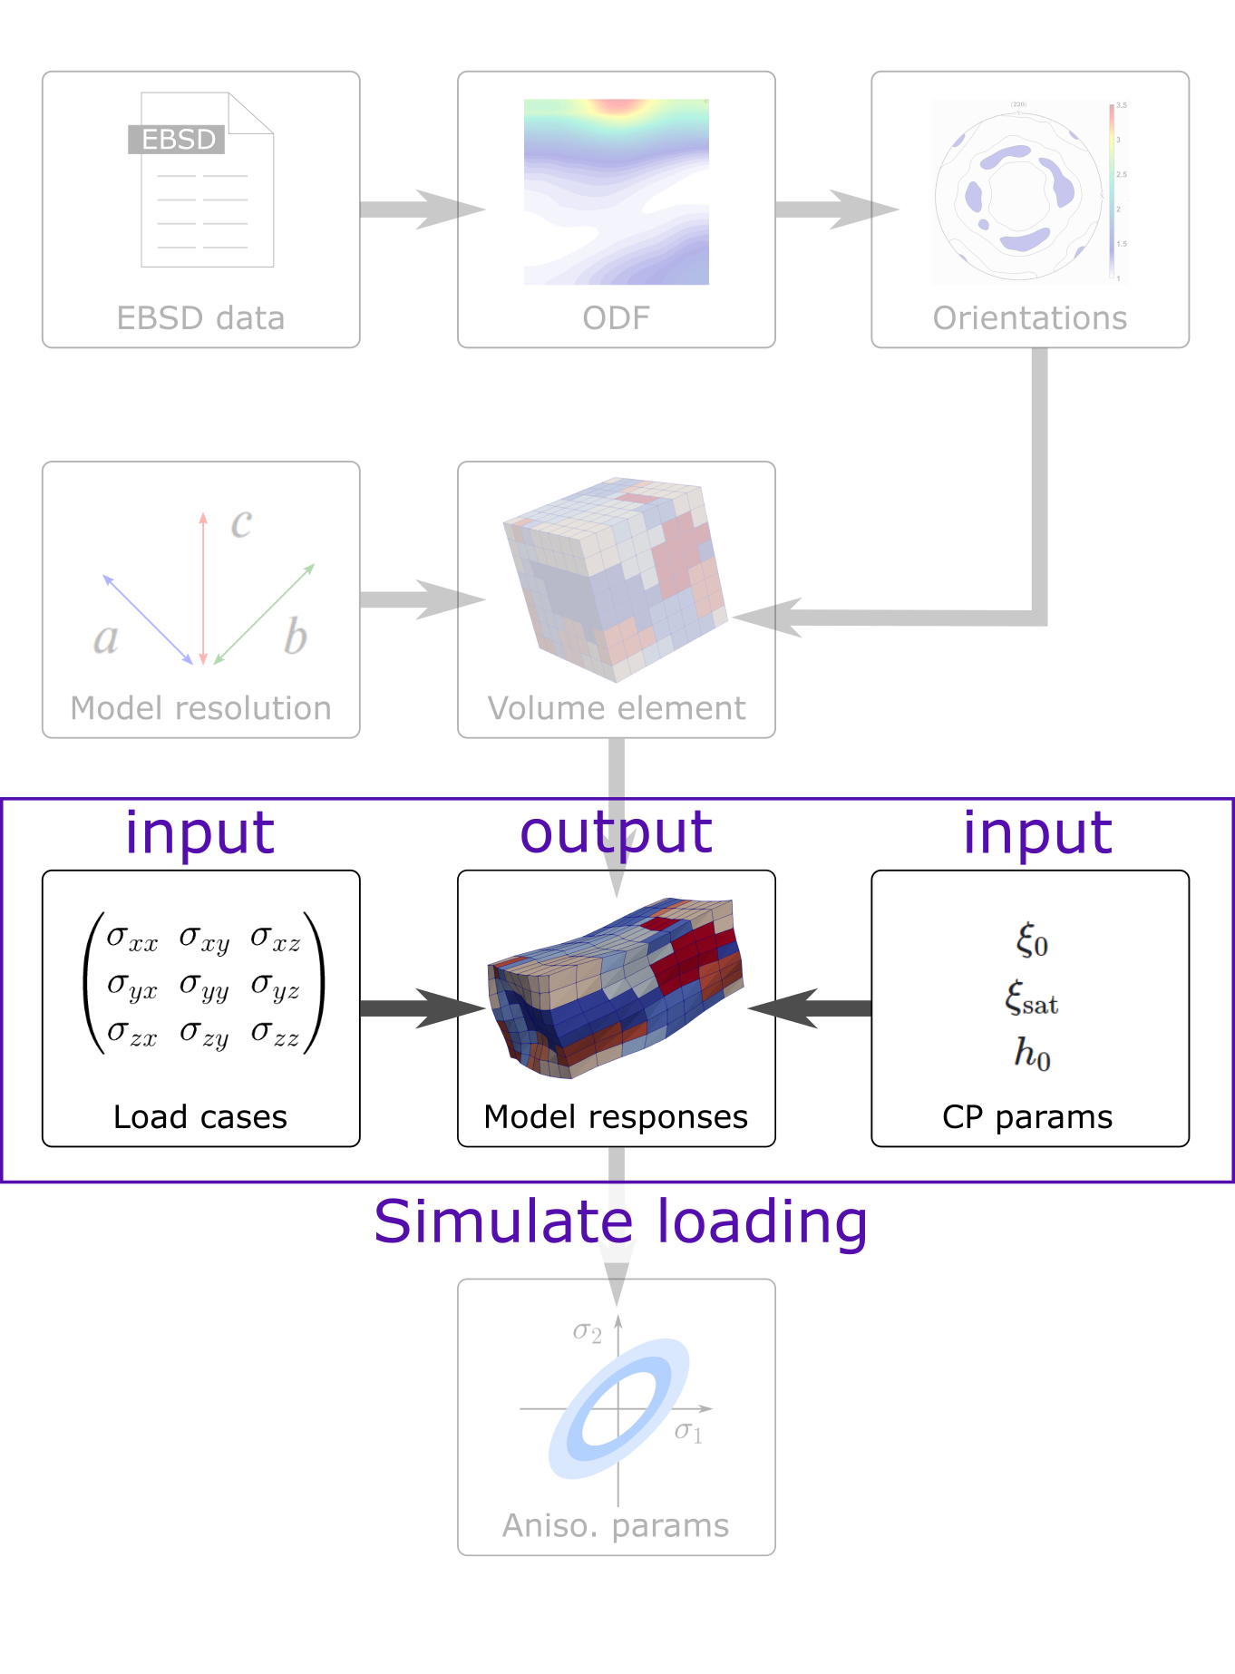

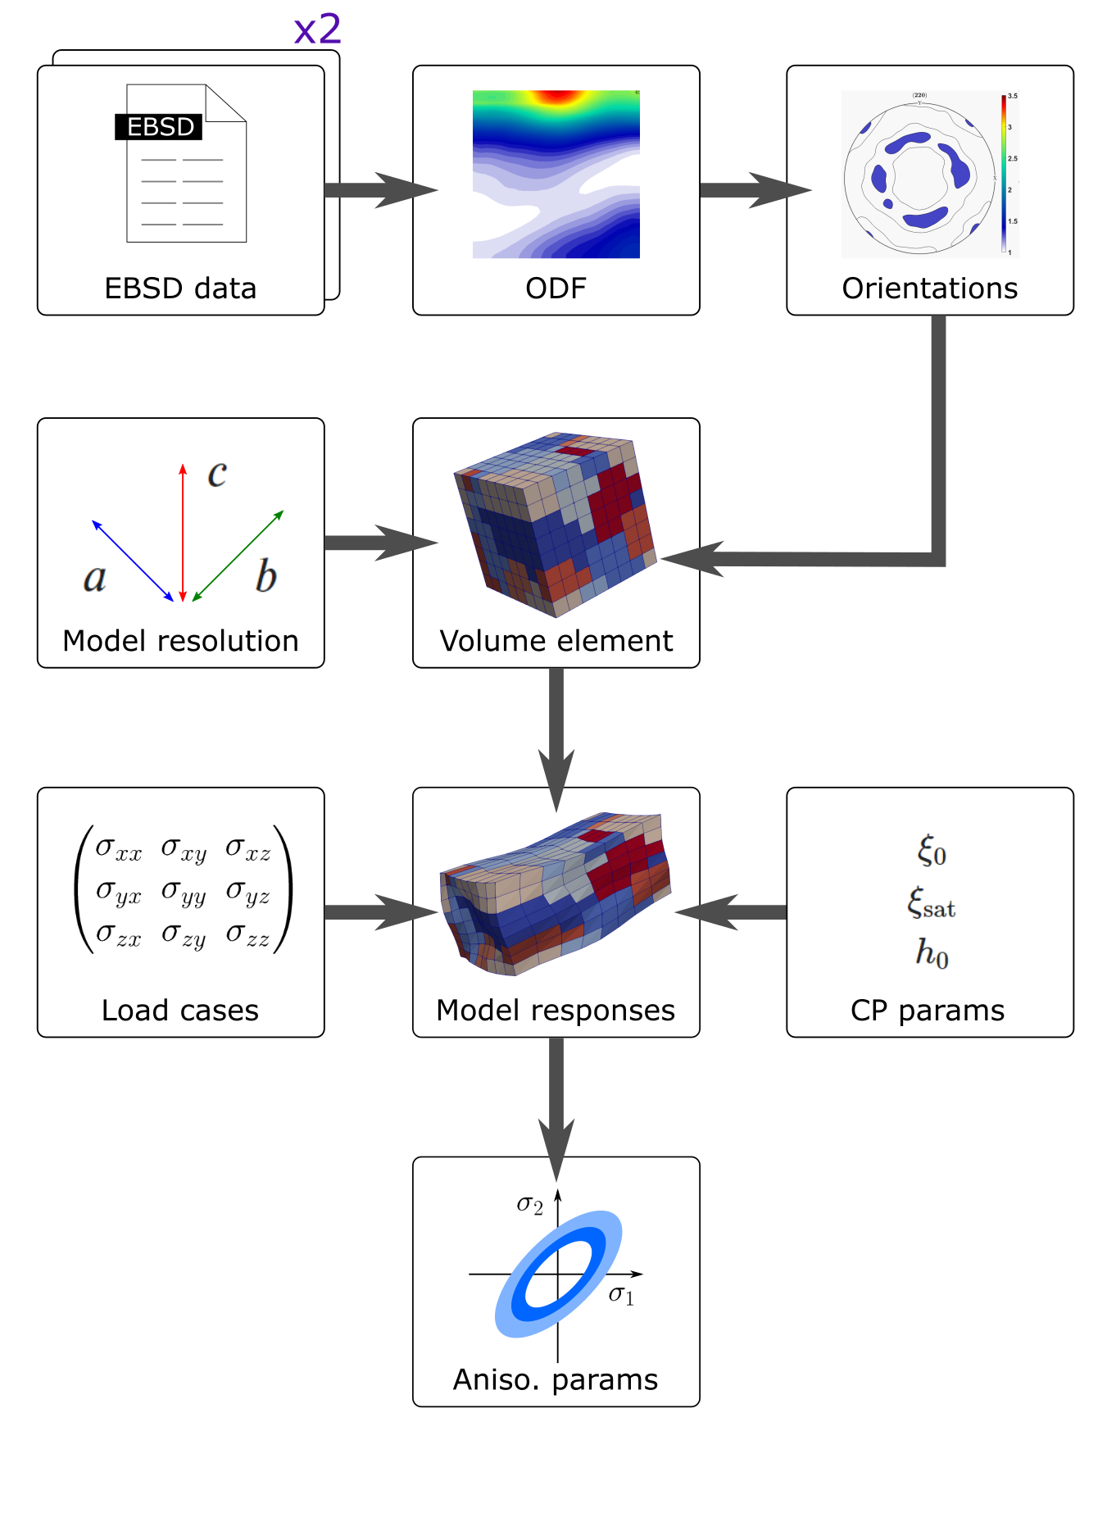
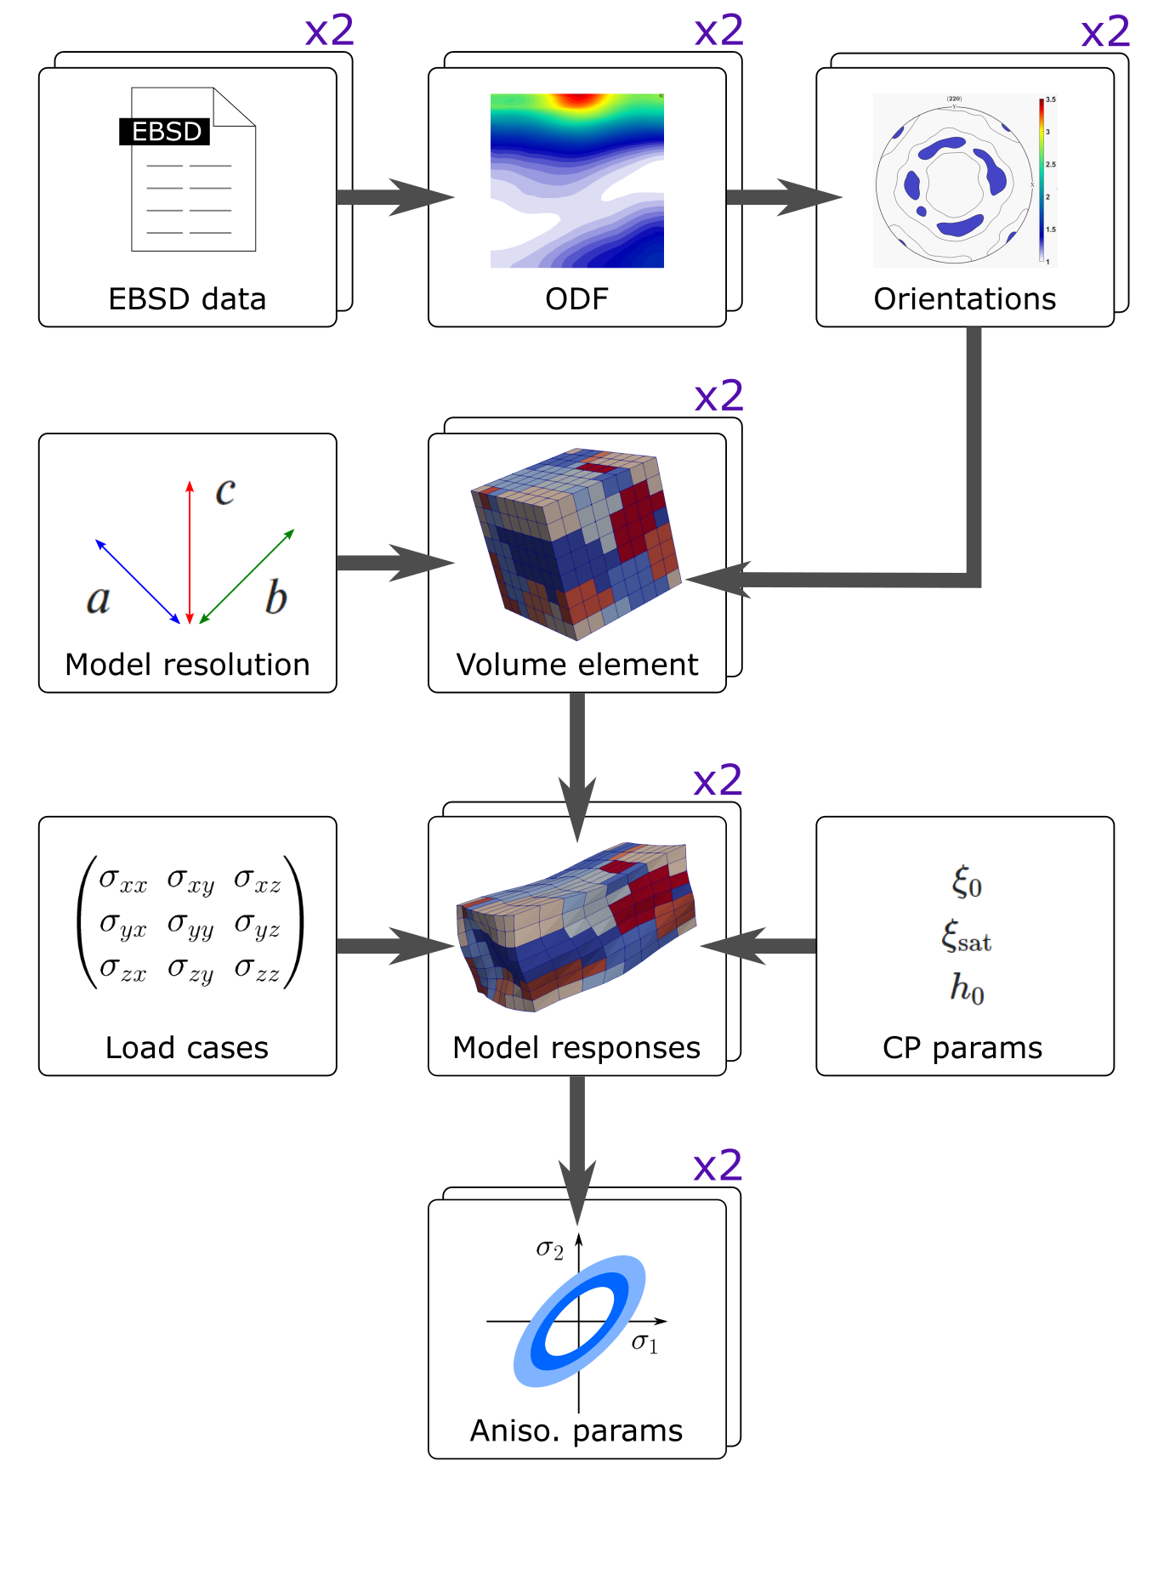
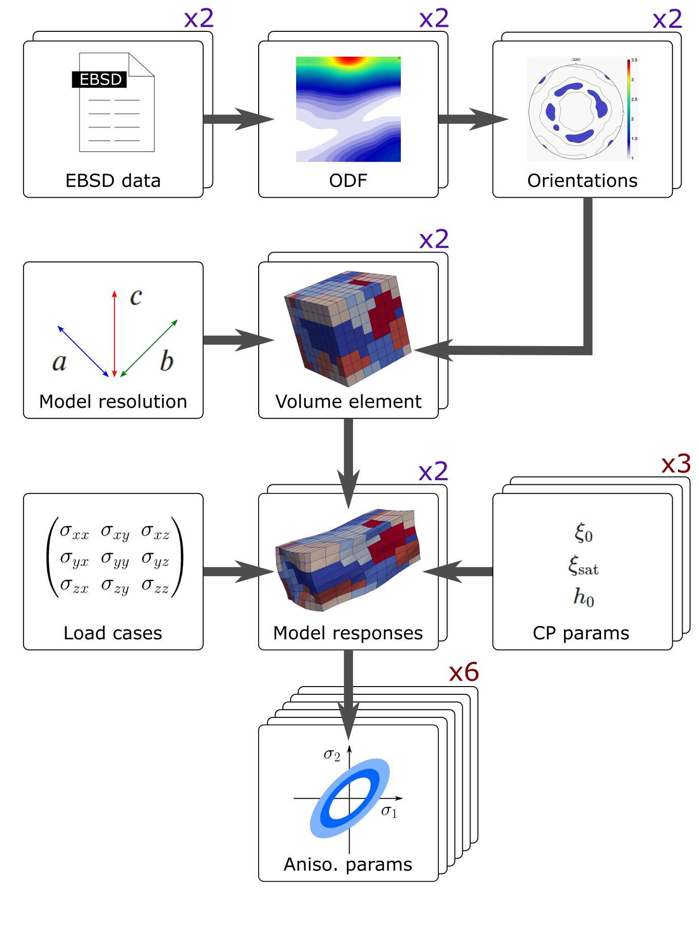
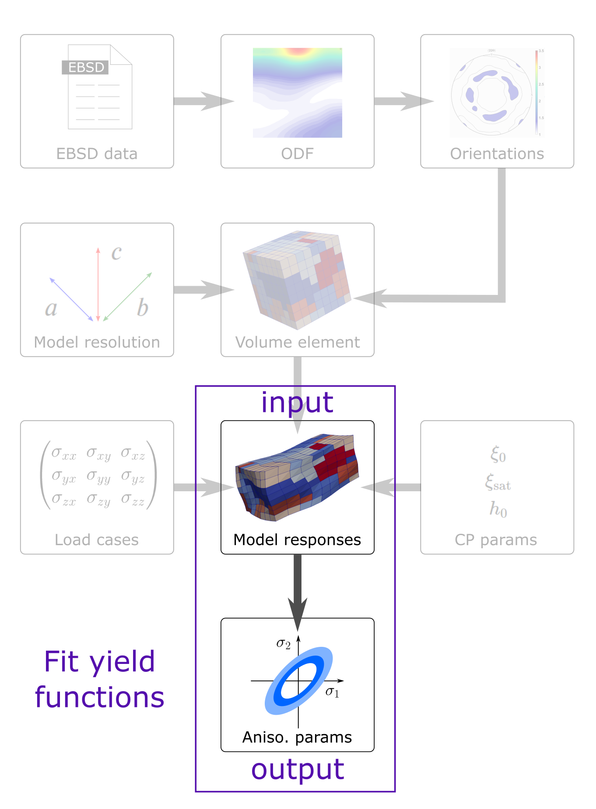
MatFlow
The workflow structure: tasks and elements
do what?
with which method?
with which software?
Task 1: estimate ODF from CTF file using MTEX
EBSD data ➔ ODF
Task 1: estimate ODF
EBSD data ➔ ODF
Task 1: get model ODF
modal direction ➔ ODF
using Dream.3D
Task 2: sample orientations
ODF ➔ orientations
Task 3: generate volume element
orientations, model resolution ➔ volume element
Task 4: simulate loading
volume element, load cases, CP parameters ➔ model responses
Task 5: fit yield functions
model responses ➔ anisotropy parameters
Data of a virtual materials test

Slide 7

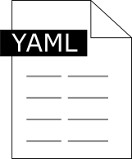




MatFlow
Using MatFlow
MatFlow installation on a cluster
matflow go profile
MatFlow extensions
matflow-DAMASK
Profile
Schemas
Software
matflow-MTEX
workflow.hdf5
matflow-DefDAP
Profile file
Machine-agnostic
Task list
Resource options (e.g. num. cores)
MatFlow
matflow-formable
Auto-archiving
Cloud storage
Public data repositories (via DataLight)
Schemas file
Machine-agnostic
Defines available tasks
Defines commands to run
Links tasks to the extension packages
Software file
Machine-specific
Defines environment to be loaded
Defines software executable names
Further analysis
DOI

Slide 8
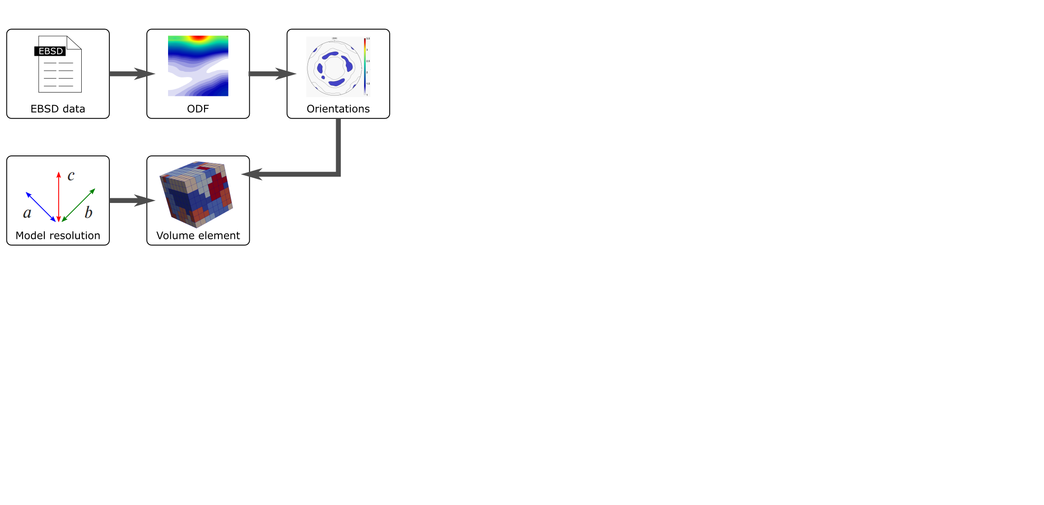
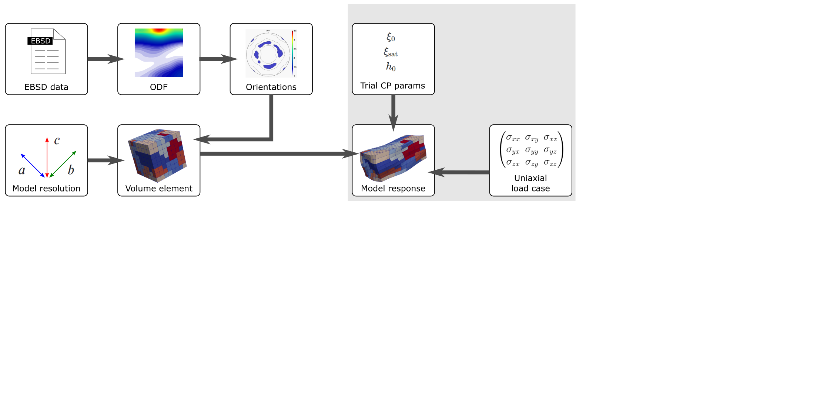
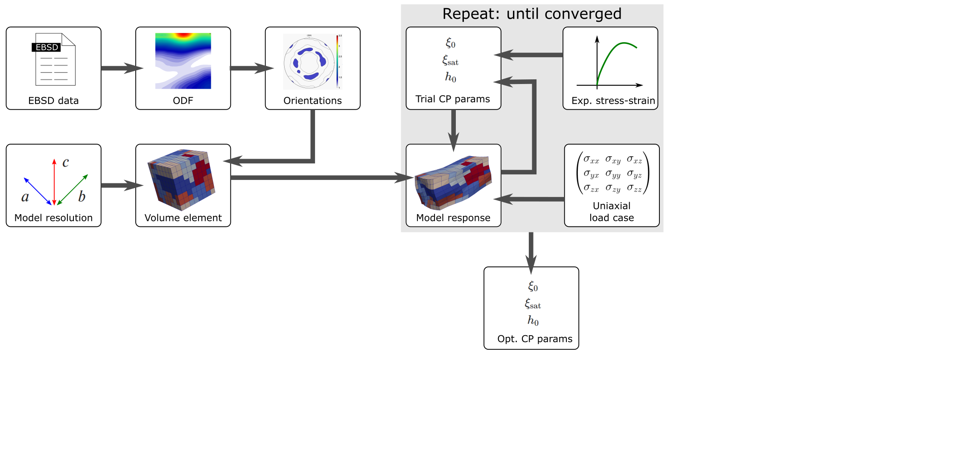
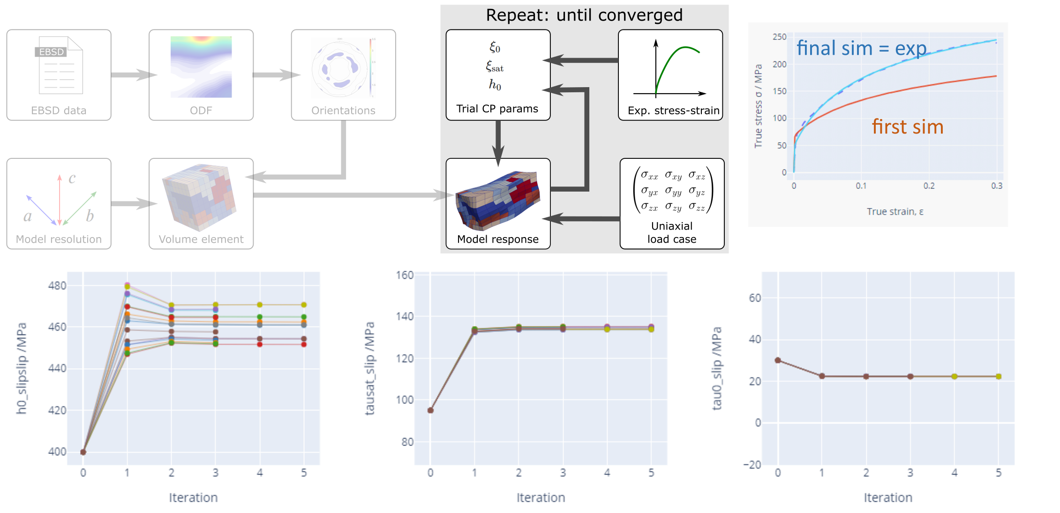

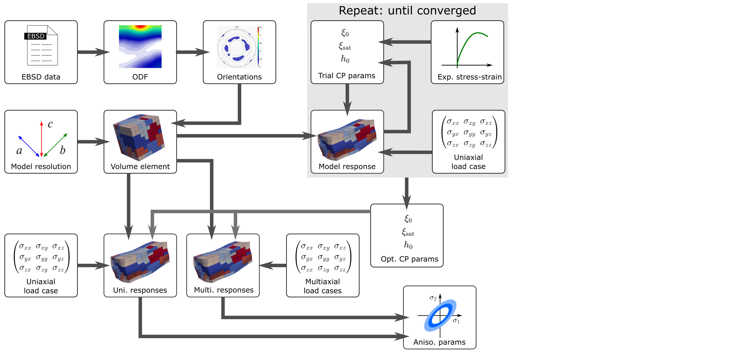
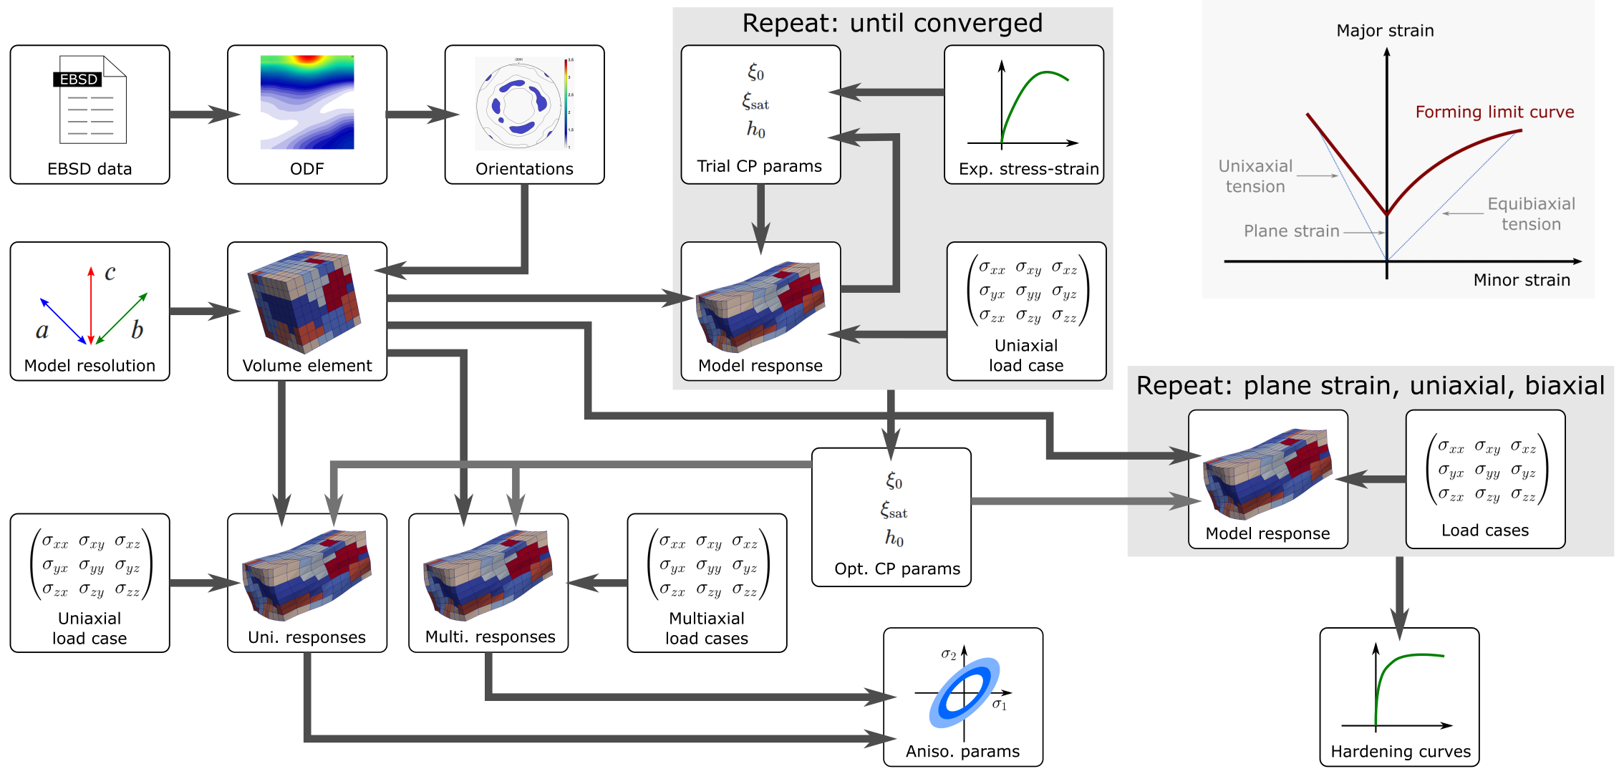
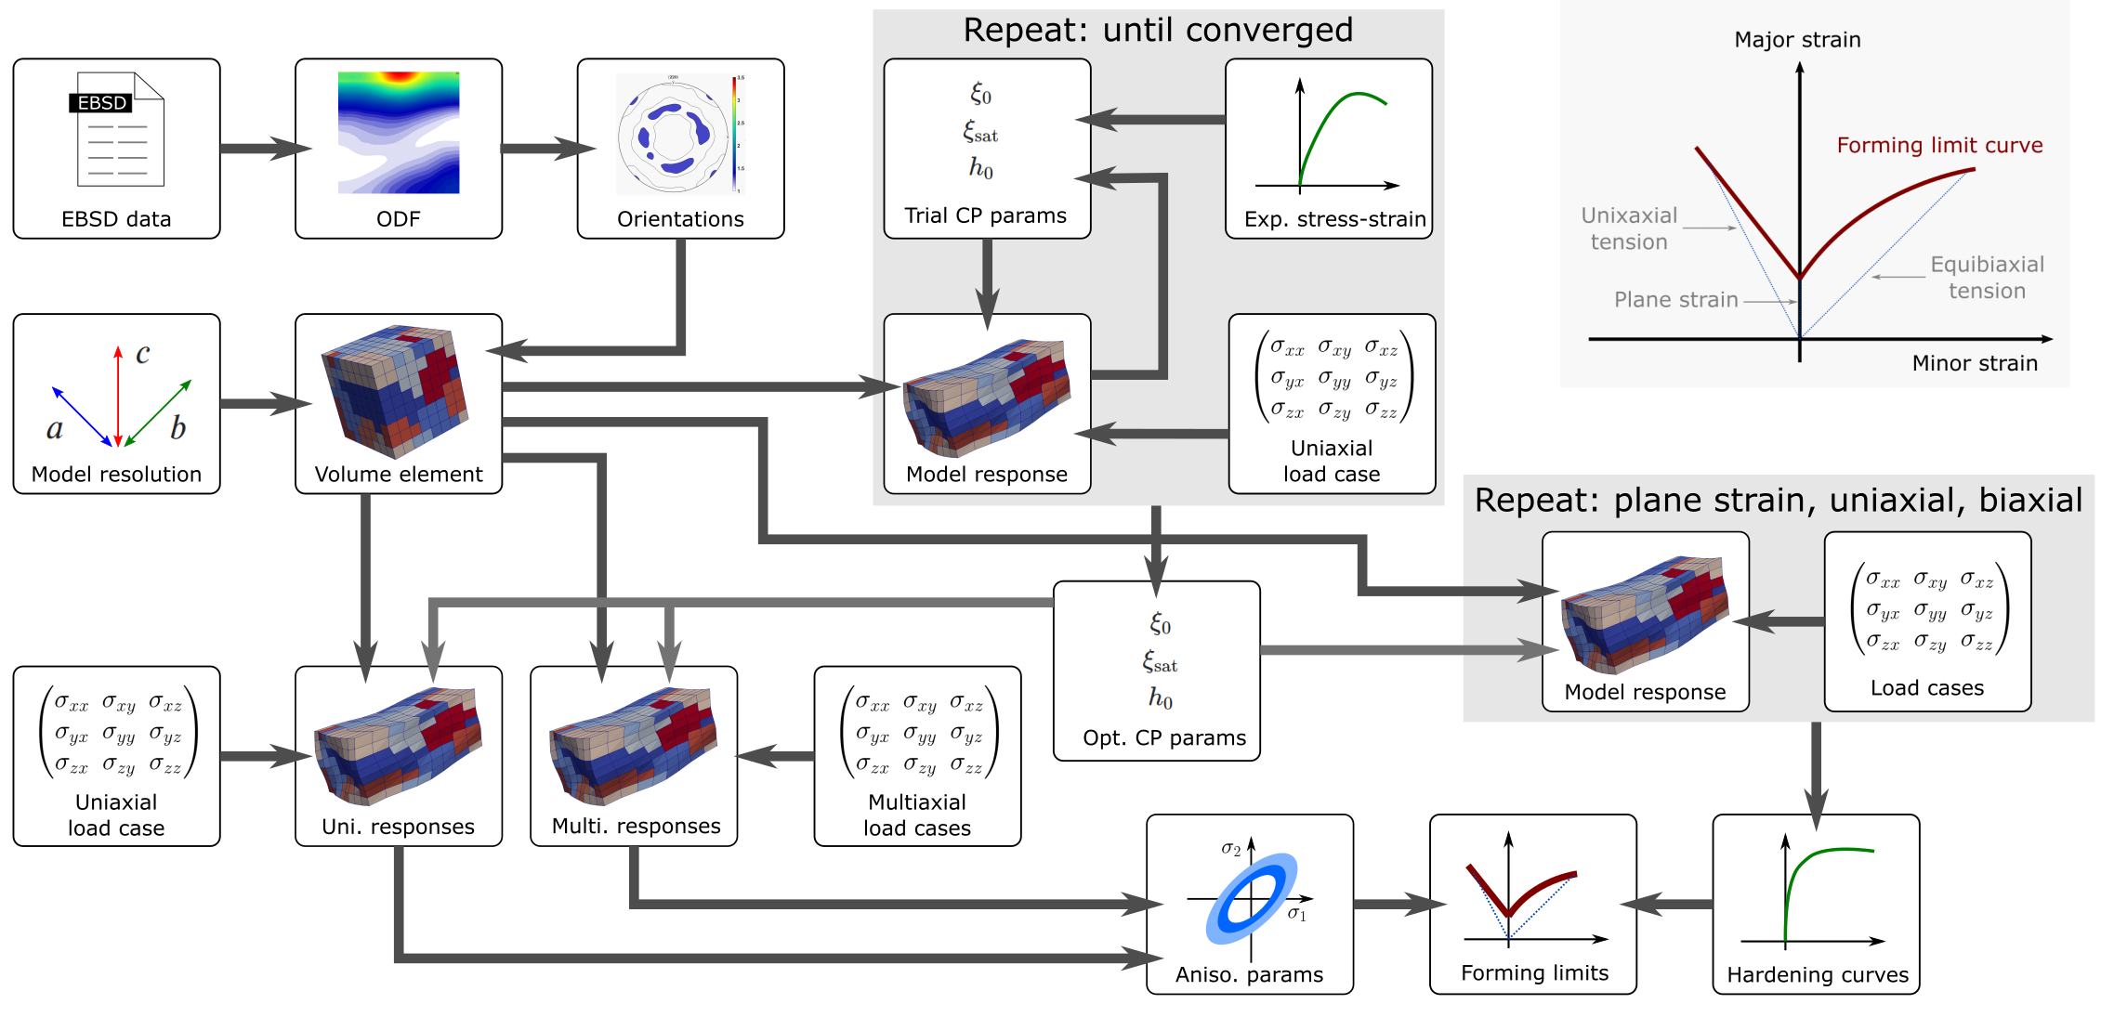
MatFlow
Generating formability predictions with MatFlow

Slide 9
Conclusions
Summary
Developed a framework for generating formability predictions, called MatFlow
Aims to streamline computational work that includes “virtual materials testing”
Workflows are structured to enable comparisons between different methods
Currently writing a paper demonstrating our use of MatFlow in making formability predictions for Surfalex (AA6016A)
Code and demos
MatFlow: github.com/LightForm-group/matflow
MatFlow extension packages: github.com/topics/matflow-software
Demo: MatFlow viewer: matflow.pythonanywhere.com
Demo: running further analysis in Jupyter: mybinder.org/v2/gh/aplowman/matflow-workflows/master
Workflows on Zenodo:
Yield function fitting: doi.org/10.5281/zenodo.4119131
Stress-strain curve: doi.org/10.5281/zenodo.4119161

